Slide 1


Transit⁺ APP
Here is where every transit user’s morning begins

Slide 2
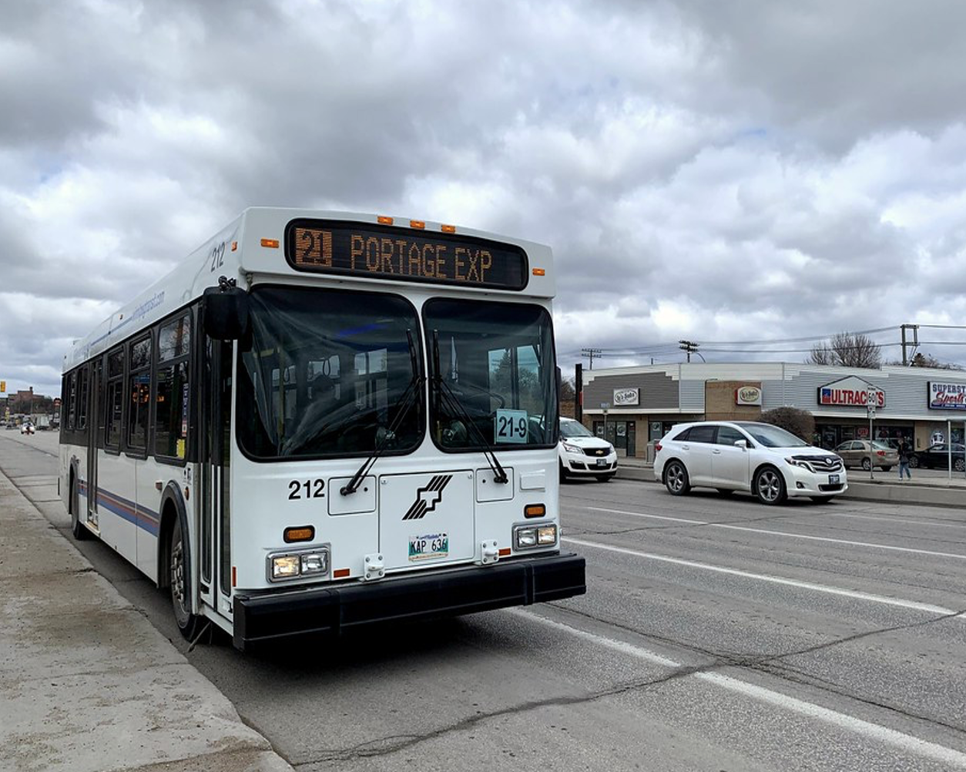
Project
Transit⁺ APP is the project we have build today.
An app that help new-comers/immigrant a relieve from struggle of longer wait time in harsh winters with all necessary informations they need for the trip all in one app.

Slide 3
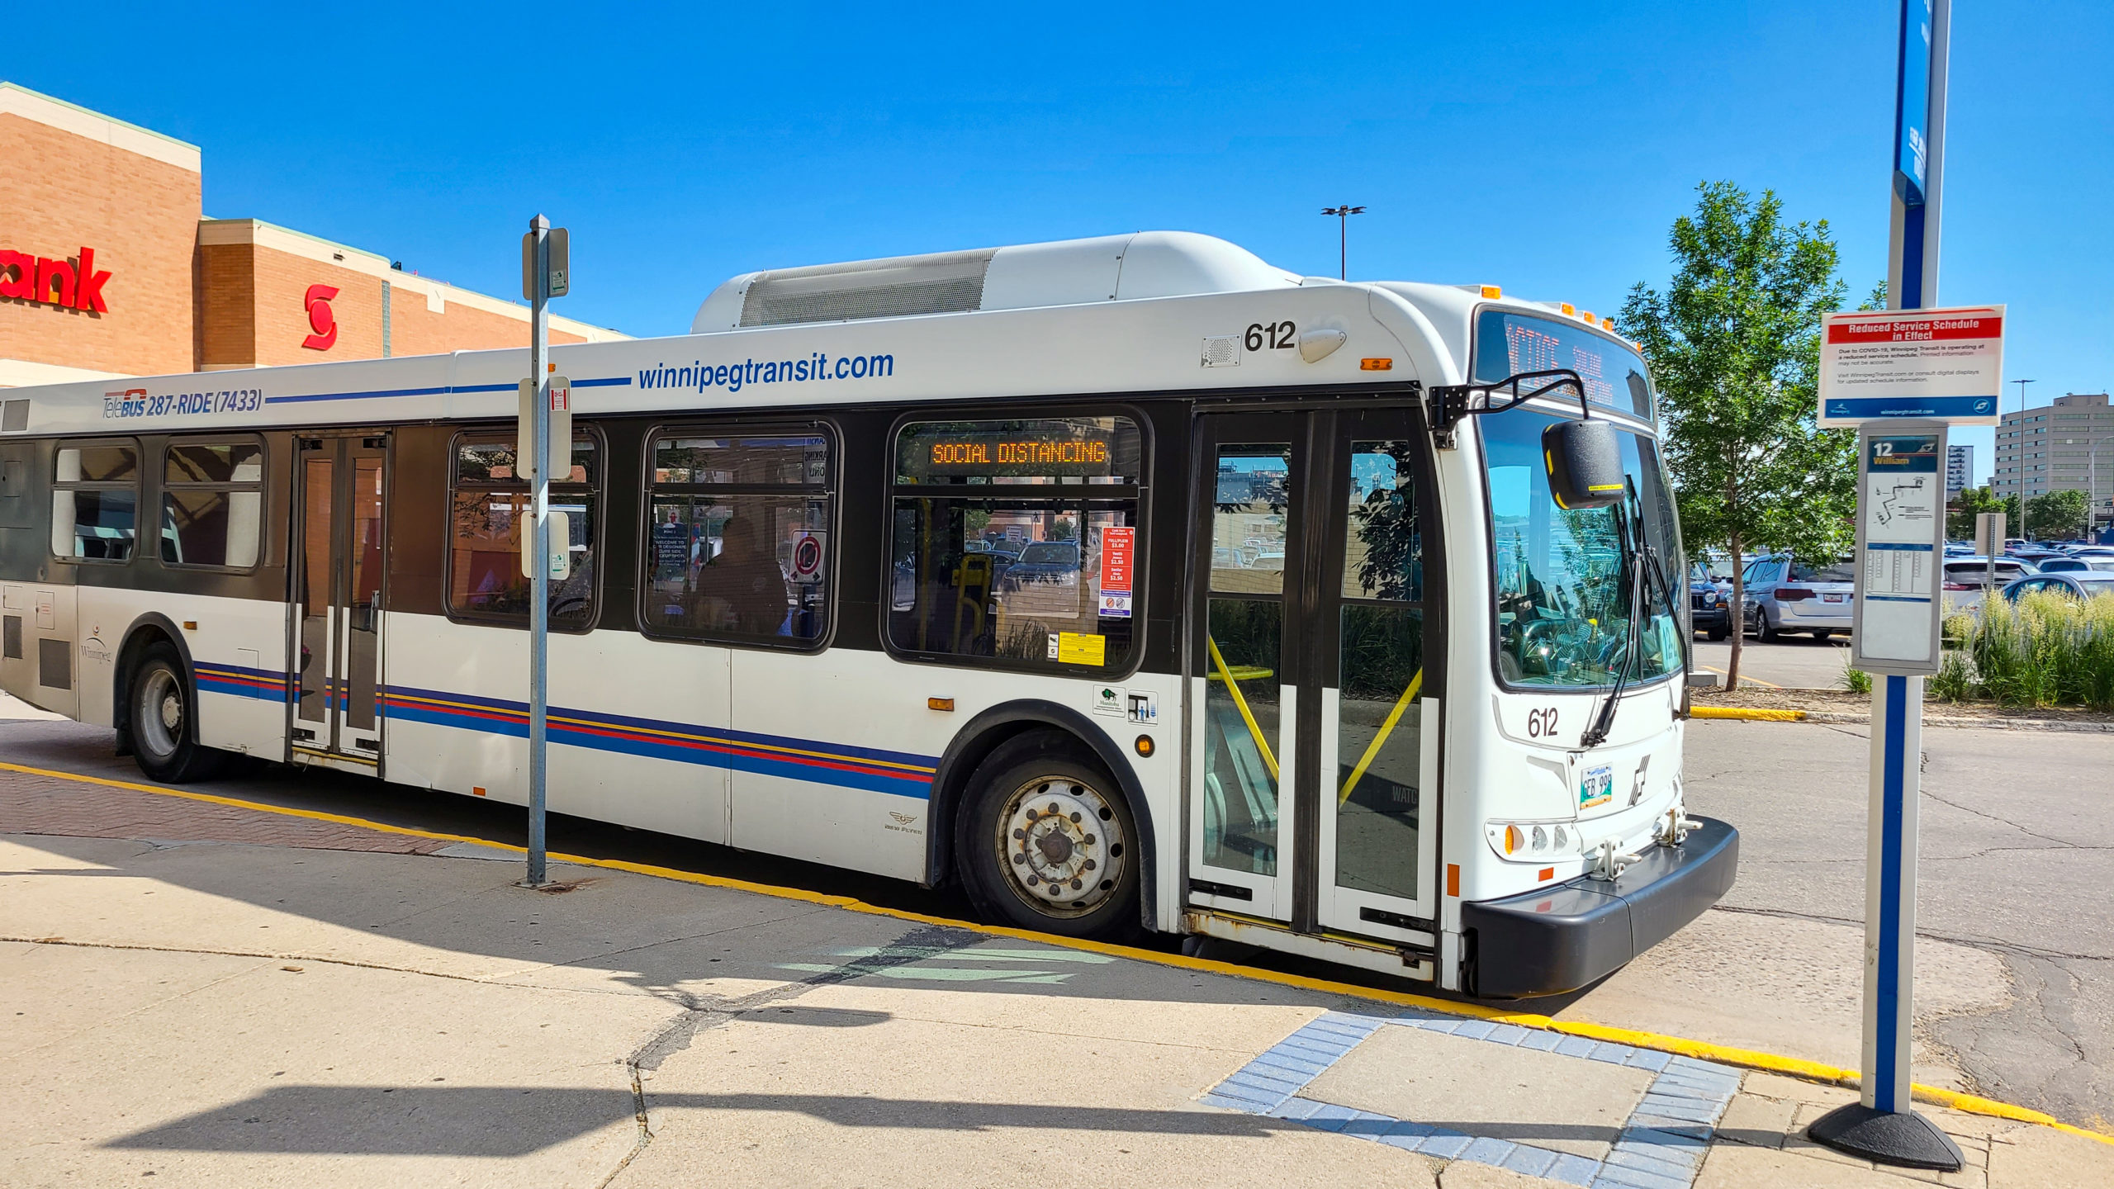
MOTIVATION
-community help – for immigrants/newcomers
single-platform (weather, transit and e-tickets)
Societal impact (reduce plastic and paper using e-tickets)

Slide 4
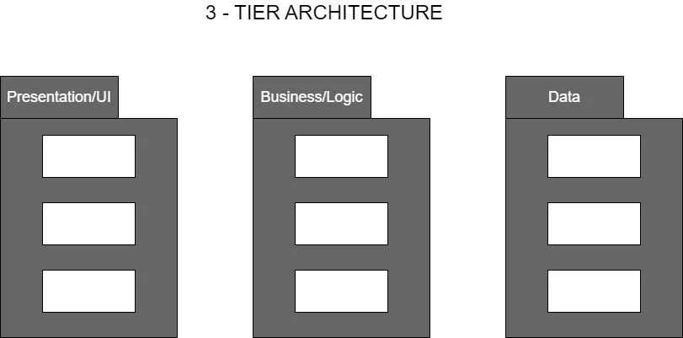
APP Architecture

Slide 5
UPCOMING FEATURES….
Maps
Distance of bus from a particular location
Information of heated bus stand

Slide 6
SWOT ANALYSIS
WEAKNESSES
THREATS
STRENGTHS
OPPORTUNITIES
Network connection for precise location tracking
Efficiency of APP
Weather and E-ticket
(single-platform APP)
Expands using of E-tickets

Slide 7
PRODUCT OVERVIEW
Stops near me
Search Bar
Departure time
Trip planning
E-ticket
Weather

Slide 8
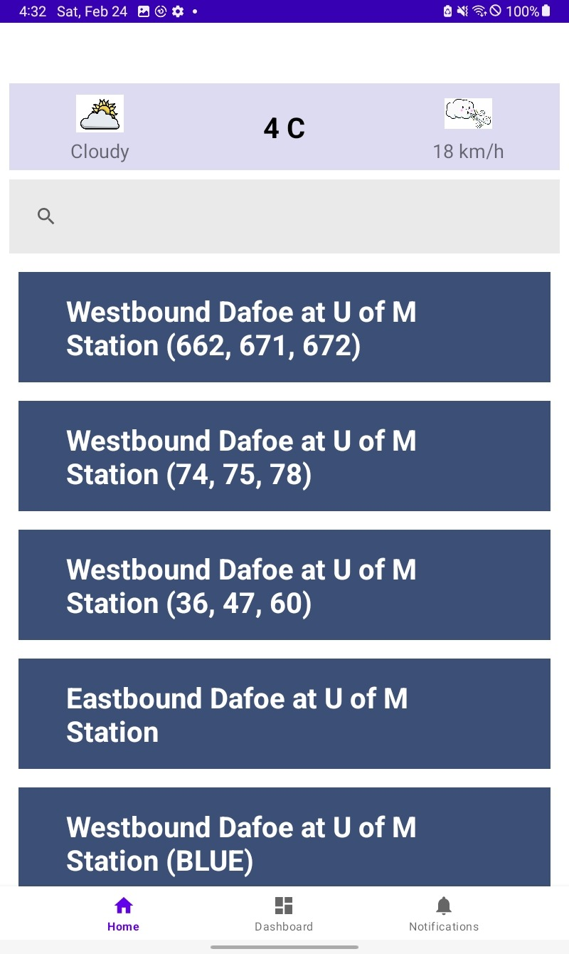
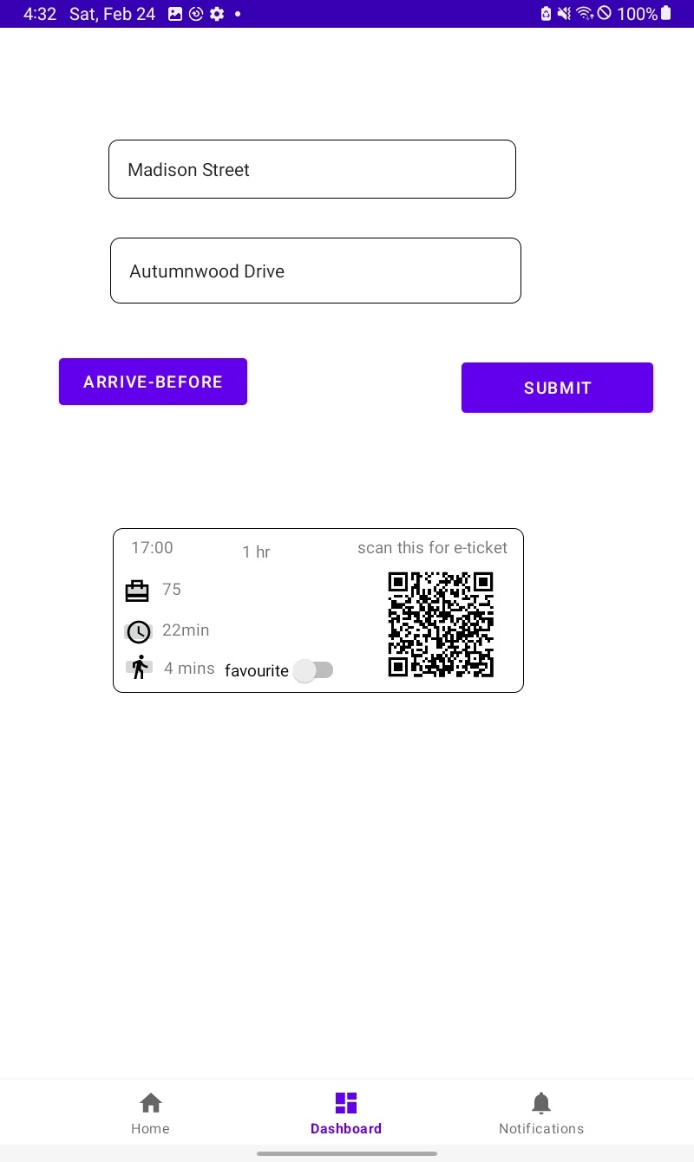
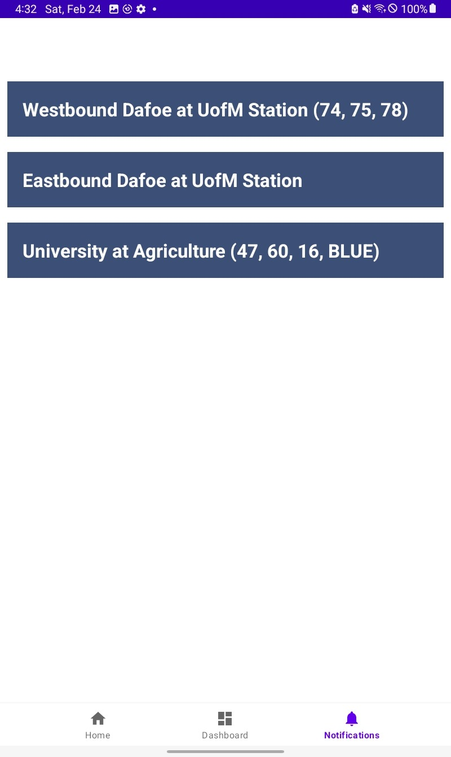
PRODUCT DEMO

Slide 9
CASE STUDY
Results
Challenge
API calls and Integration
Precise weather information and location

Slide 10

THANKS!
Hope you all enjoyed our transit APP
WINNIPEG TRANSIT IS BEST ☺
Please keep this slide for attribution.

